Slide 1



Slide 2

Last lecture reminder
We learned about:
What is a database
Why we are using computers as our databases
Relational databases and non-relational databases
What is the Database Management System (DBMS)
What are database queries
Relational database tables, columns and rows
Relational database primary keys and foreign keys
Relational database composite keys

Slide 3
Introduction To SQL
SQL (Structured Query Language) - SQL is the language we use to perform actions on our databases. We are doing it by interact with the relational database management system (RDMS).
We are using SQL to perform actions like:
Create / update / delete entity from a SQL table
Get data from SQL table
Create / delete an entire SQL table
Perform administrative tasks (security, import / export data … )
Note: SQL is not a programming language, but it still a very powerful language.

Slide 4

Introduction To SQL
As we learned, we have different types of RDMS such as: MySQL, SQL-Server, SQLite…
Every RDMS that we chose is using the SQL to perform interaction with the client but we could see some differences in the syntax of the languash between different RDMS.
What is important for us to understand is that the concept of SQL remain the same between all the RDMS.

Slide 5
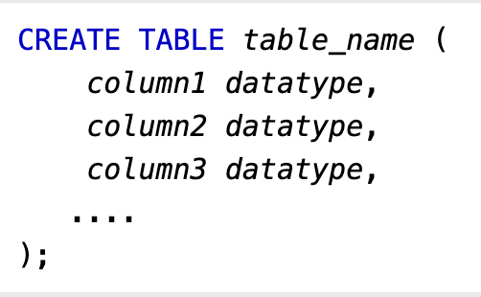
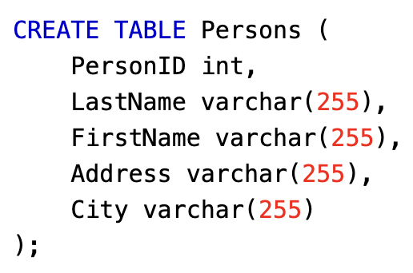
The CREATE TABLE Query
CREATE TABLE - Allow us to create new database table.
Query schema →
Query Example →

Slide 6
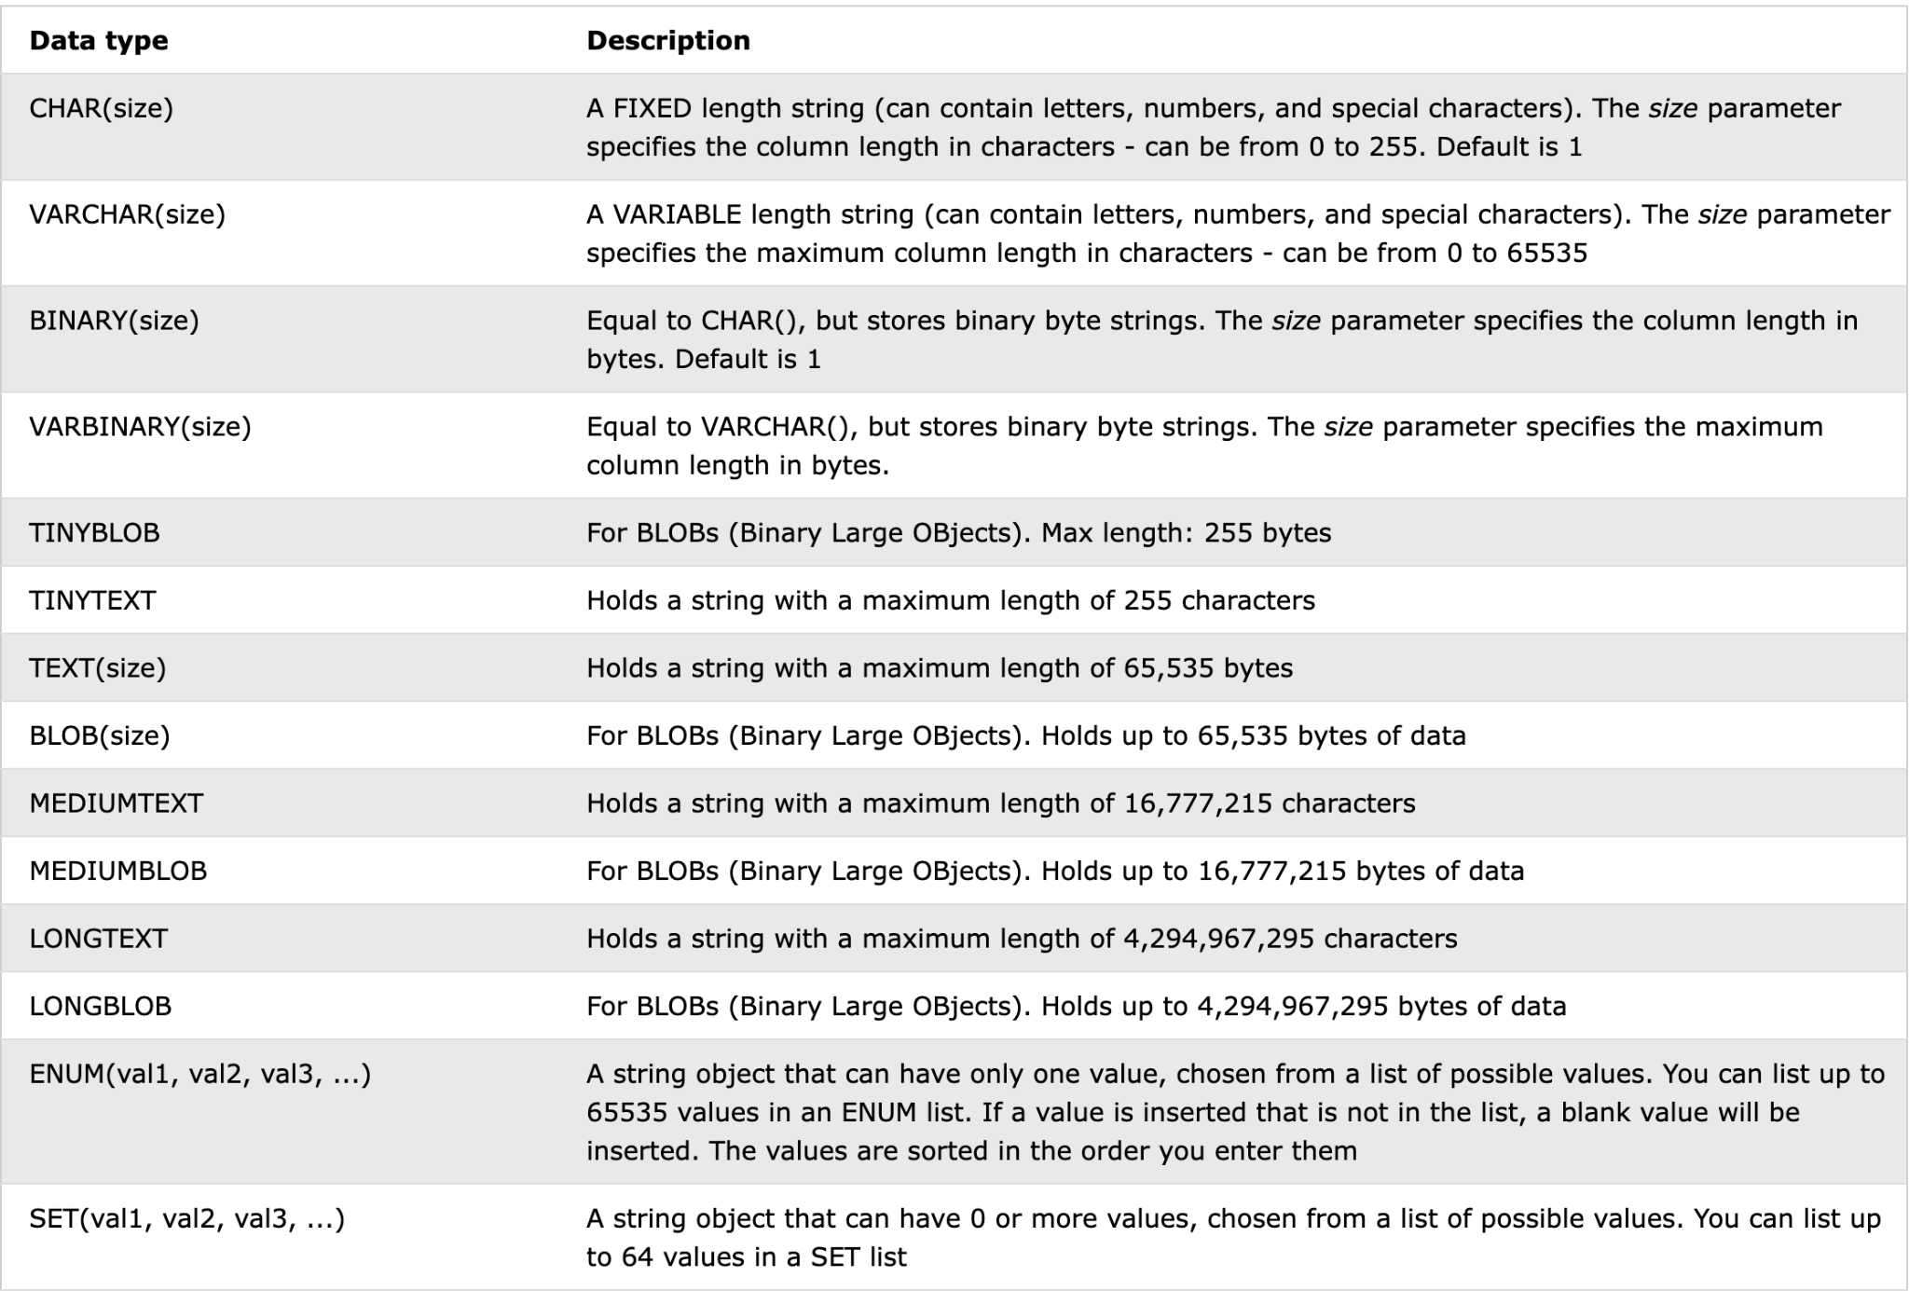
String Column Data Types

Slide 7
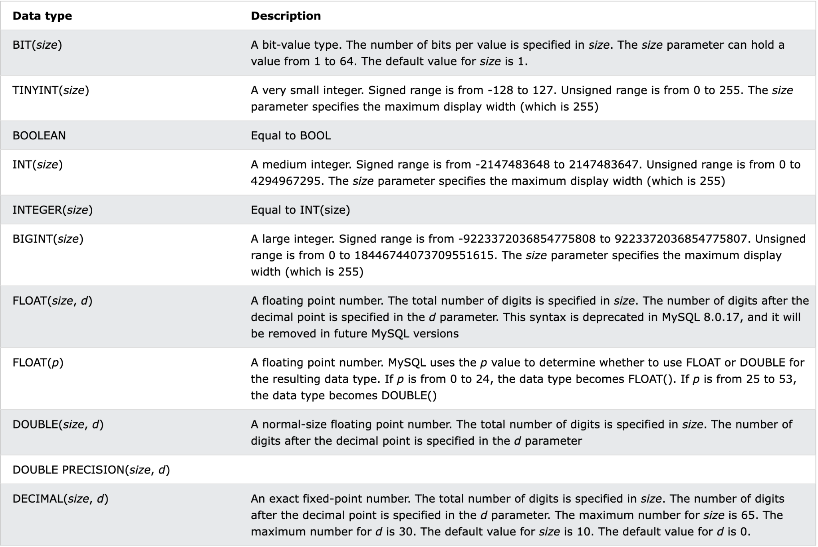
Number Column Data Types

Slide 8
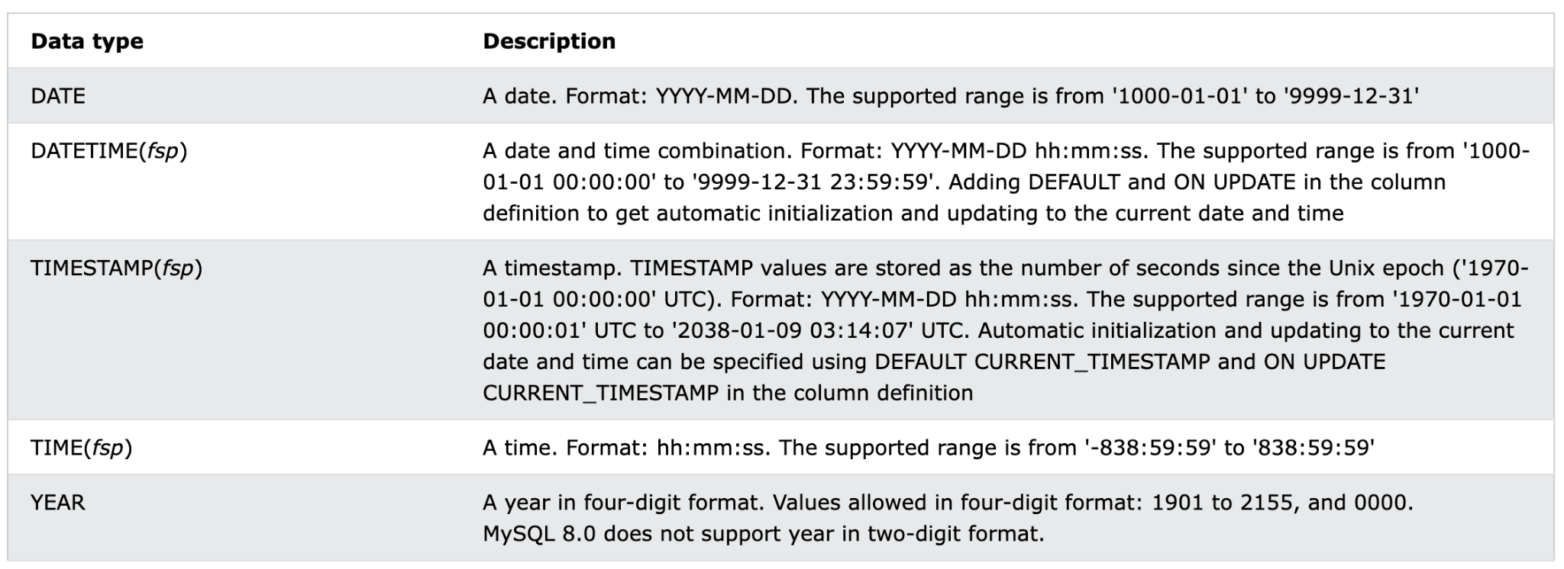
Date and Time Data Types

Slide 9
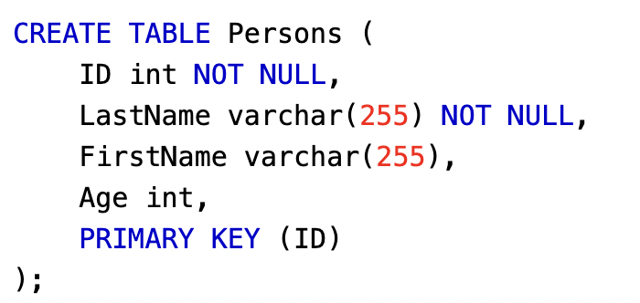
The CREATE TABLE Query
Primary Key - Once we have all the columns we want in the table we can add in the CREATE query the primary key:
PRIMARY KEY ({column name})
Example:
When configuring a primary key, we have to also add NOT NULL to the primary key column. Meaning this field can’t be null

Slide 10
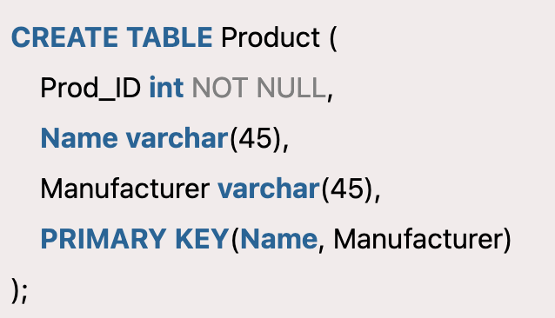
The CREATE TABLE Query
Composite Primary Key - In the same way we can also configure composite primary key.
PRIMARY KEY ({column name}, {column name}, {...})
Example:
In this table the primary key is composite primary key that combine the name column and the manufacture column

Slide 11
The CREATE TABLE Query
Foreign Key - After configuring the primary key we can also add foreign keys if we need to.
FOREIGN KEY ({column name}) REFERENCES {table name}({column name})
First column name → The name of the column in the table that should be a foreign key.
Table name → The name of the table with the primary key that we want our foreign key to reference to.
Second column name → The name of the primary key column in the table we are reference to.

Slide 12
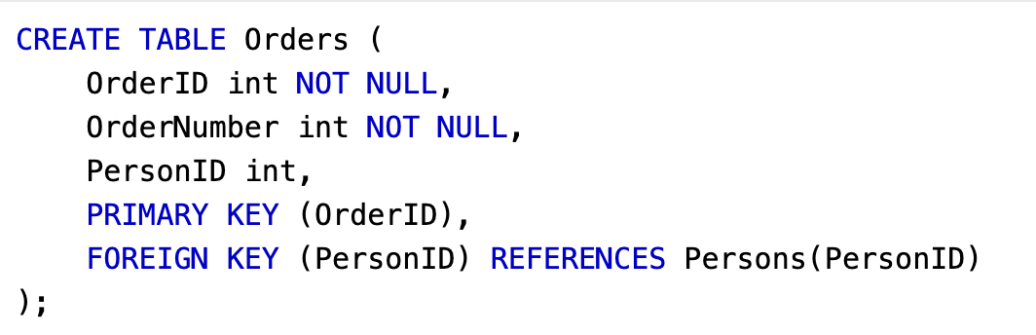
The CREATE TABLE Query
Foreign Key example:
Note: If possible the foreign key column name should be identical to the referenced primary key column name. This can solve a lot of confusions regarding the connection between both columns.
The personID column is a foreign key to another table
The referenced table is Person table, and the referenced primary key is PersonID column

Slide 13
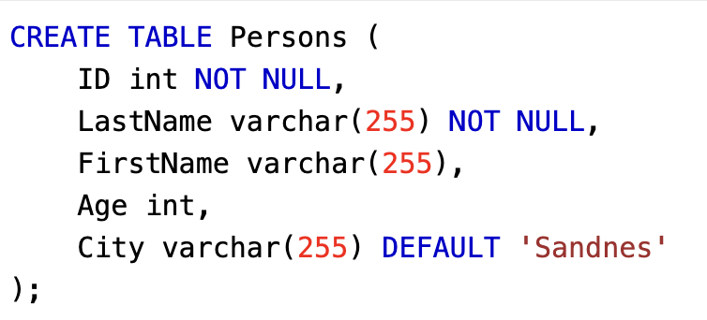
The CREATE TABLE Query
The DEFAULT keyword → When creating a table we maybe will want to configure a default value in case this column came with null value. The DEFAULT keyword allow us to do that, we can also configure a default value of NULL as well.
If we are not providing any column to the city field it will be added with “Sandnes” name as default.

Slide 14
The CREATE TABLE Query - Best Practices
When creating a new database table we want to create it with the most standard way so we want to make sure our table execute those best practices:
Table name will always be in singal. For example: person, student, course … not students, persons, courses…
Table name will always contain only lowercase letters.
When having more than one word in the table name, we will separate the words with “_”. For example: store_item, user_account …
Column names will be with lowercase and will be seperated with “_” as well.
Primary Key and Foregin Key configurations will always add to the end of the CREATE TABLE query.

Slide 15
Class Exercise - Create Database Tables
Instructions:
Go to the website: https://sqliteonline.com/ and select on the left navbar MySQL Create a database tables that represent the following:
Employees table → save employe data such as: employe id, first name, last name, email, phone number, start working date, finish working date, is manager
Managers to employees relationship table → save for each employe what is his manager. every employee must have a direct manager and only one direct manager. Not all managers must have employes
Positions table → Save the relationship between the employee and the position he has. Every employee must have at least one position (but it can have more than one), and every position must be occupied by at least one employee.
Make sure your table schemas are aligned to the best practices we learned

Slide 16
Class Exercise Solution - Create Database Tables

Slide 17
MySQL Table Related Queries
DROP TABLE query → Allow us to delete a table from the database
DROP TABLE {table name}
ALTER TABLE query → Allow us to update the schema of existing table, with ALTER TABLE query we can change column name, add keys, change data types and more. ALTER TABLE {table name}
ADD {column name} {data type}

Slide 18

SQL Constraints
SQL constraints are used to specify rules for the data in a table. Constraints are used to limit the type of data that can go into a table. This ensures the accuracy and reliability of the data in the table. If there is any violation between the constraint and the data action, the action is aborted. Constraints can be column level or table level. Column level constraints apply to a column, and table level constraints apply to the whole table.

Slide 19
SQL Constraints
The following constraints are commonly used in SQL:
NOT NULL → Ensures that a column cannot have a NULL value
UNIQUE → Ensures that all values in a column are different
PRIMARY KEY → A combination of a NOT NULL and UNIQUE. Uniquely identifies each row in a table
FOREIGN KEY → Prevents actions that would destroy links between tables
CHECK → Ensures that the values in a column satisfies a specific condition
DEFAULT → Sets a default value for a column if no value is specified
CREATE INDEX → Used to create and retrieve data from the database very quickly

Slide 20
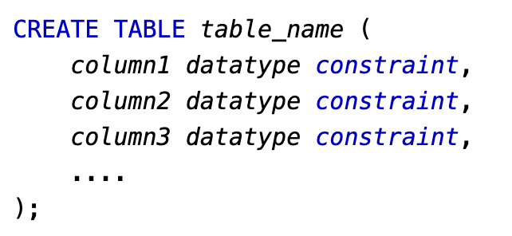
SQL Constraints
We can add constraints to a new table by providing them in the CREATE TABLE query or we can add constraints to an existing table with the ALTER TABLE query. Example:

Slide 21
Class Exercise - Update Database Tables
Instructions:
Go to the website: https://sqliteonline.com/ and select on the left navbar MySQL Open the previous exercise solution and implement the following:
Choose in total 3 different columns from all the tables you have and modify them by using the ALTER TABLE query.
Add the UNIQUE constraint to the positions table meaning that every position can appear only once.
Find a way to save the relationship between the employees and the position with the UNIQUE constraints, meaning that the position itself can appears only once in the position table but we still can have more than one employee that work on the same position.

Slide 22
Class Exercise Solution - Update Database Tables

